Slide 1
Release Train #2 IVVQ Status August 09, 2017

Slide 2
Release Train #2 Themes Status August 9, 2017

Slide 3
Release Train#2 IVVQ Testing Status August 9, 2017

Slide 4
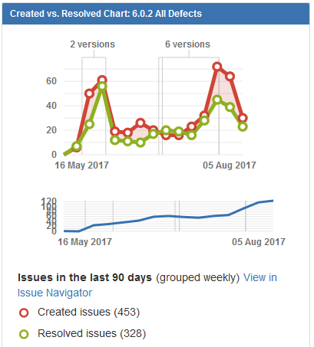
Release Train #2 Created Vs Resolved JIRA Incidents

Slide 5
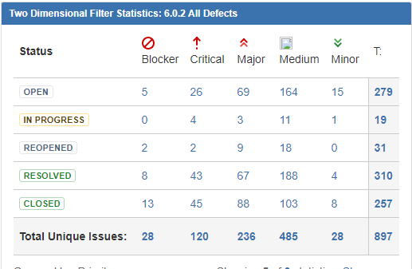
Release Train #2 Jira Incidents Statistics for current release

Slide 6
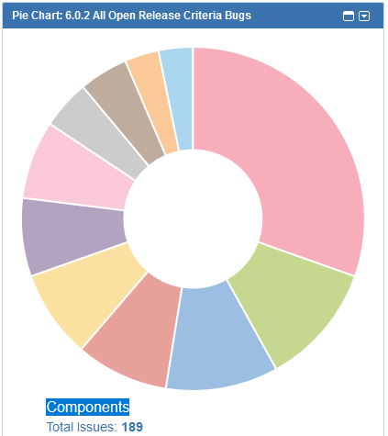
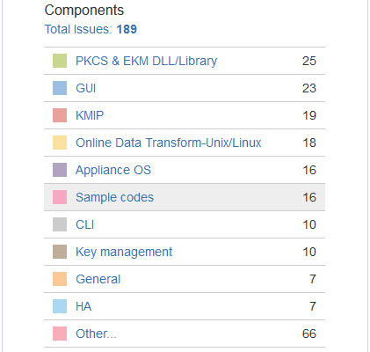
IVVQ Release Train #2 Criteria Open Jira Incidents

Slide 7
Current DSM 6.0.2 Status
KMIP Early Access testing – In progress
IBM GDE 3.0 testing – In progress
Build to QA 6.0.2.5020
9 Jira incident resolved in above drop to DSMQA for DPM, DSM disk encryption, KMIP and CLI network fixes
30 defects logged in Jira this week
Test case execution exceeded (planned = 40, executed 63)

Slide 8
Current Linux VTE 6.0.2 Status
Build 6.0.2.21
Redhat 7.4 platform support, fixes for internal found defects and escalations
Test blocker issue: AGT-15950: 6.0.2.20 VTE build failed to install on Ubuntu 16
Accessing 6.0.2 project impacts for new requests for the following changes:
RHEL 7.4/Ubuntu 16.04.03 will be supported in 6.0.1 patch release; SLES 12 SP3 support will be evaluated. LDT support with RHEL 7.4 will be 6.0.1 September patch (no impact to 6.0.2 release)
Docker Open shift release is pulled in from 6.0.2 to 6.0.1 August patch release (no impact to 6.0.2 release)
Supporting common host setting for host group (Regular/LDT, Docker, HDFS, GPFS – still to be evaluated)
GPFS 4.1.1.4 support with PureScale with DB2 11 (we support GPFS 3.5 with DB2 10.5 at this moment – still to be evaluated)
Supporting Amazon S3 storage in 6.0.2 (QA can only test this in post 6.0.2)
Continue to work on VTE QA Jira ticket for visibility in jira structure plugin (has dependency on development/PM)

Slide 9
Current Windows VTE 6.0.2 Status
Build 6.0.2.15 ~ 6.0.2.22
EA features
Active Directory
Critical escalation fixes
Internal found defects
Current QA testing focus:
Active directory in Local and Azure environment
EA(Early access) in local and Azure environment
MS SQL in Azure and local environment
Regression testing
Functional testing of log logging threshold

Slide 10
Backup Slides Release Train #2 IVVQ Status August 09, 2017

Slide 11
List of DSM New Feature Status
Jira # | New Feature | Jira Status
 | DPM | In Progress
 | KMIP | In Progress
PM-996 | DSM ECC external Web Cert to use 256 Key | Resolved
PM-1196 | V6100 reset requires New Cards, and cannot use existing cards/world | Resolved
PM-1102 | Automate registration of host with LDT/Docker option "on" | Open
PM-1221 | LDT/Docker option at a host group level | Open
PM-1280 | Backup and HA replication failure alerts on the DSM | Open
PM-1288 | DSM Disk Encryption | In Progress
In Progress – Feature partially delivered to QA, development still in progress
Resolved – Development and QA Jira ticket linked with PM ticket are closed
Open – Development and QA Jira ticket are Open state

Slide 12
List of DSM Improvements Status
Jira # | New Feature | Jira Status
PM-876 | Increase agent logging threshold beyond 100MB | Resolved
PM-1281 | Cloud based software form factors for the DSM must be built for every DSM release along with the existing form factors | Open
PM-1282 | Support DHCP and static IP addresses for the DSM in enterprise and cloud environments | In Progress
PM-1310 | SHA-1 Removal | Open (development Resolved)
PM-1095 | DSM-Agent Registration protocol must be secured | Open (development Resolved)
In Progress – Feature partially delivered to QA, development is still in progress.
Resolved – Development and QA Jira ticket linked with PM ticket are closed
Open – Development and QA Jira ticket are Open state

Slide 13
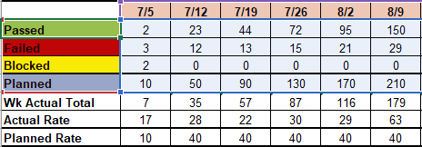
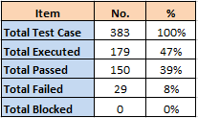
DSM Test Case Metrics

Slide 14
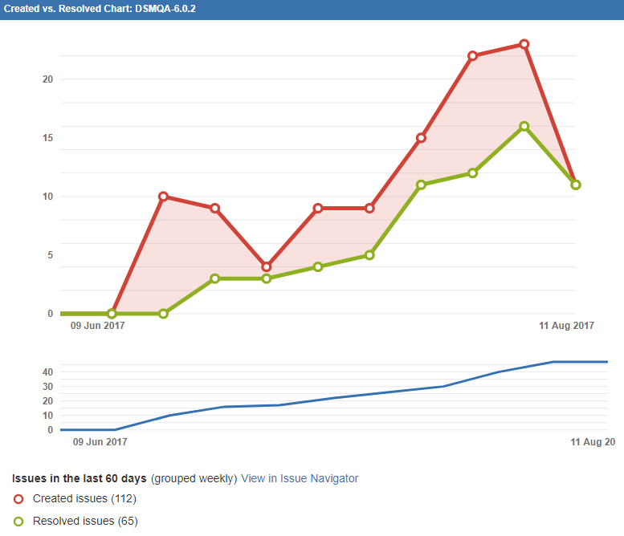
DSM6.0.2 Created Vs Resolved JIRA Incidents

Slide 15
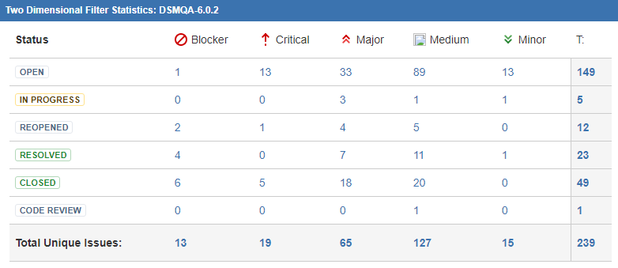
Total DSM Jira Incidents Statistics for current release

Slide 16
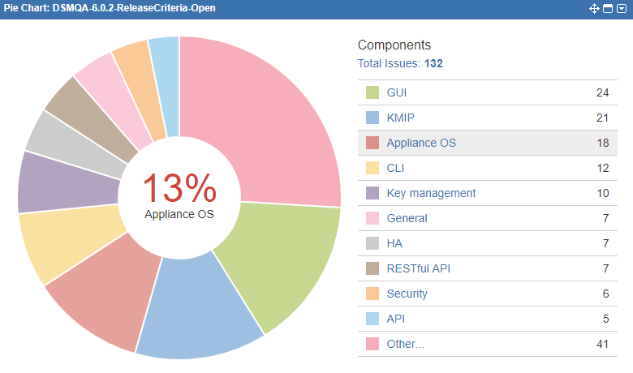
DSM Release Criteria Open Jira Incidents

Slide 17
LDT Linux Test Case Metrics
 | 7/12/2017 | 7/19/2017 | 7/26/2017 | 8/2/2017 | 8/9/2017
Passed | 12 | 41 | 59 | 81 | 121
Failed | 1 | 2 | 3 | 10 | 12
Blocked | 0 | 0 | 0 | 0 | 0
Planned | 20 | 40 | 70 | 110 | 160
Wk Actual Total | 13 | 43 | 62 | 91 | 133
Actual Rate | 13 | 30 | 19 | 29 | 42
Planned Rate | 20 | 20 | 30 | 40 | 50
Item | No | %
Total Test Case | 471 | 100%
Total Executed | 133 | 28%
Total Passed | 121 | 26%
Total Failed | 12 | 3%
Total Blocked | 0 | 0%

Slide 18
General Linux VTE Test Case Metrics
 | 7/12/2017 | 7/19/2017 | 7/26/2017 | 8/2/2017 | 8/9/2017
Passed | 65 | 95 | 121 | 151 | 197
Failed | 4 | 4 | 7 | 9 | 12
Blocked | 3 | 3 | 0 | 0 | 1
Planned | 50 | 90 | 130 | 170 | 220
Wk Actual Total | 72 | 102 | 128 | 160 | 210
Actual Rate | 72 | 30 | 26 | 32 | 50
Planned Rate | 50 | 40 | 40 | 40 | 50
Item | No | %
Total Test Case | 588 | 100%
Total Executed | 210 | 36%
Total Passed | 197 | 34%
Total Failed | 12 | 2%
Total Blocked | 1 | 0%

Slide 19
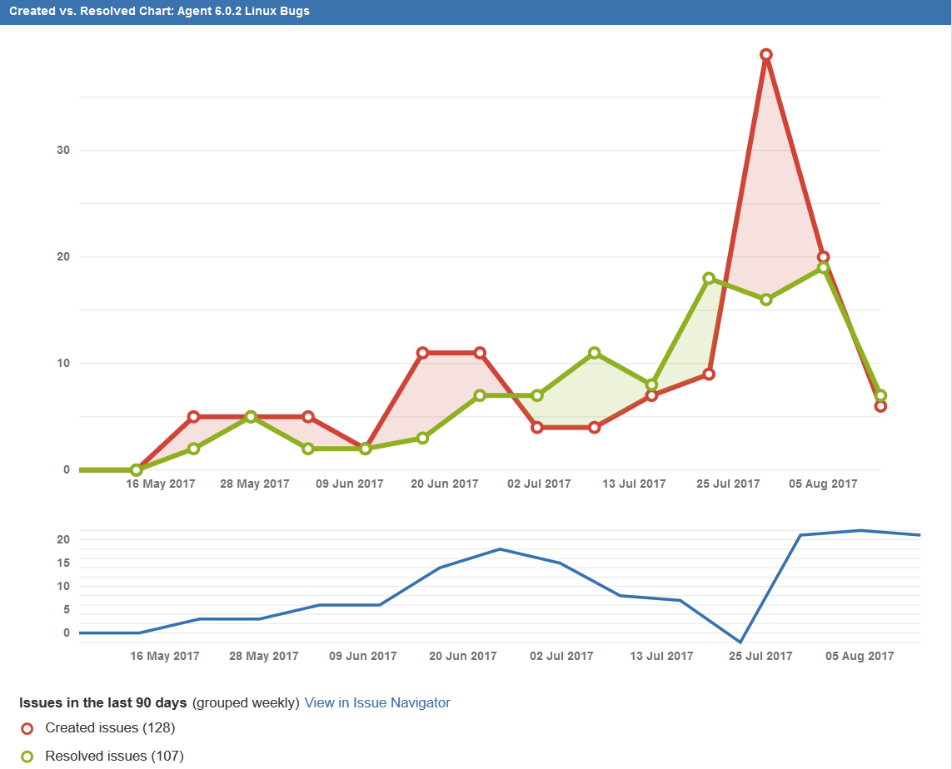
Linux 6.0.2 Created Vs Resolved JIRA Incidents
https://jira.vormetric.com/issues/?filter=16455

Slide 20
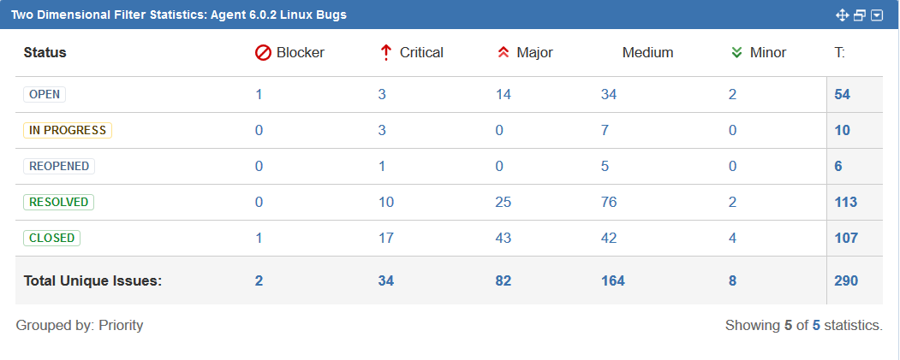
Total Linux Jira Incidents Statistics for current release

Slide 21
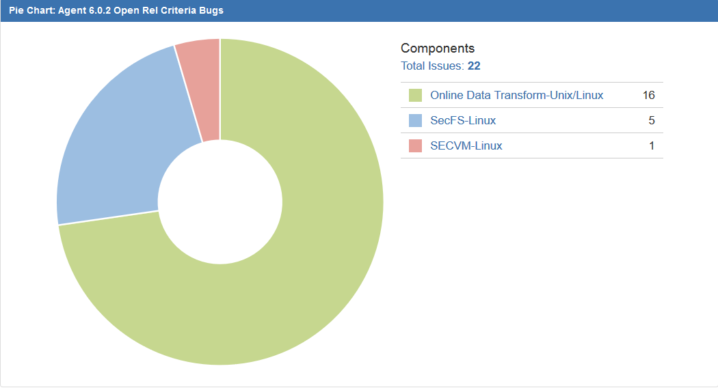
Linux Release Criteria Open Jira Incidents

Slide 22
Windows VTE 6.0.2 Regression Test Case Metrics
 | 7/12/2017 | 7/19/2017 | 7/26/2017 | 8/2/2017 | 8/9/2017
Passed | 100 | 137 | 325 | 338 | 345
Failed | 0 | 5 | 5 | 5 | 9
Blocked | 0 | 0 | 0 | 0 | 0
Planned | 100 | 130 | 160 | 190 | 220
Wk Actual Total | 100 | 142 | 330 | 343 | 354
Actual Rate | 100 | 42 | 188 | 13 | 11
Planned Rate | 20 | 30 | 30 | 30 | 30
Item | No | %
Total Test Case | 446 | n/a
Total Executed | 354 | 79%
Total Passed | 345 | 77%
Total Failed | 9 | 2%
Total Blocked | 0 | 0%

Slide 23
Windows 6.0.2 Created Vs Resolved JIRA Incidents
https://jira.vormetric.com/secure/Dashboard.jspa?selectPageId=13803#Created-vs.-Resolved-Chart/16047

Slide 24
Total Windows Jira Incidents Statistics for current release

Slide 25
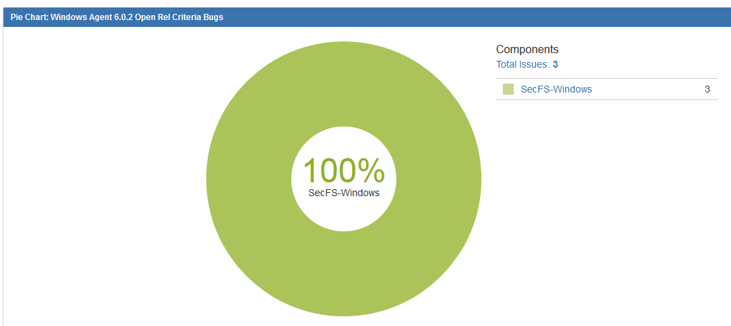
Windows Release Criteria Open Jira Incidents

